Slide 1



Amazon SQL PROJECT
E-Commerce
Structured query language (SQL) is a programming language for storing and processing information in a relational database. A relational database stores information in tabular form, with rows and columns representing different data attributes and the various relationships between the data values

Slide 2
Amazon E-Commerce Data Analysis & Optimization
Project Overview:
This project focuses on analyzing Amazon's e-commerce data using advanced SQL techniques.
The goal is to optimize database queries, extract key business insights, and
enhance decision-making for sales, orders, and seller performance.
Key Topics Covered:
Problem Statements – Addressing 20 key business challenges in e-commerce data analytics.
Joins – Combining multiple tables (orders, products, sellers, customers) to generate meaningful insights.
Common Table Expressions (CTEs) – Simplifying complex queries for improved readability and efficiency.
Stored Procedures – Automating tasks such as identifying inactive sellers, analyzing product performance, and tracking order trends.
Functions – Creating reusable SQL functions for calculations and data transformations.
Project Objectives:
✅ Identify inactive sellers who haven't received orders in the last 6 months. ✅ Analyze product performance by calculating total sales, order count, and quantity sold. ✅ Track order trends based on status (Completed, Pending, Canceled) and yearly performance. ✅ Optimize SQL queries to enhance performance and reduce execution time. ✅ Automate data retrieval using stored procedures and functions.
Expected Outcomes:
✔ Optimized SQL queries for Amazon's e-commerce data analysis. ✔ Automated reports for seller activity, product performance, and order trends. ✔ Enhanced decision-making with structured and well-organized data. ✔ Improved SQL skills in handling large-scale e-commerce datasets.

Slide 3
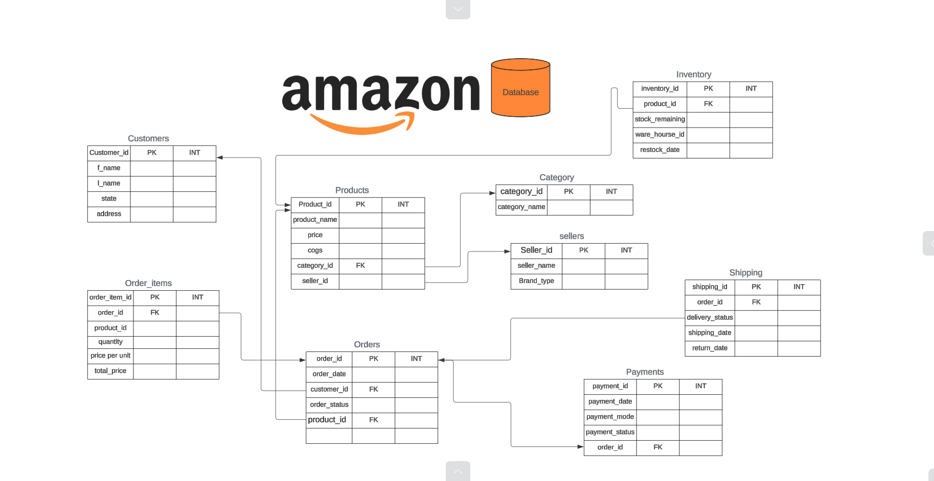
ERD (Entity Relationship Diagram)

Slide 4
ERD Relationships:
Customers → Orders: One-to-Many (Customer places multiple Orders)
Orders → Order_Items: One-to-Many (Each Order can have multiple Order_Items)
Order_Items → Products: Many-to-One (Each Order_Item refers to one Product)
Products → Category: Many-to-One (Each Product belongs to one Category)
Sellers → Products: One-to-Many (Each Seller manages multiple Products)
Orders → Payments: One-to-One (Each Order has one Payment)
Orders → Shipping: One-to-One (Each Order has one Shipping record)
Products → Inventory: One-to-One or One-to-Many (Depending on how inventory is managed)

Slide 5
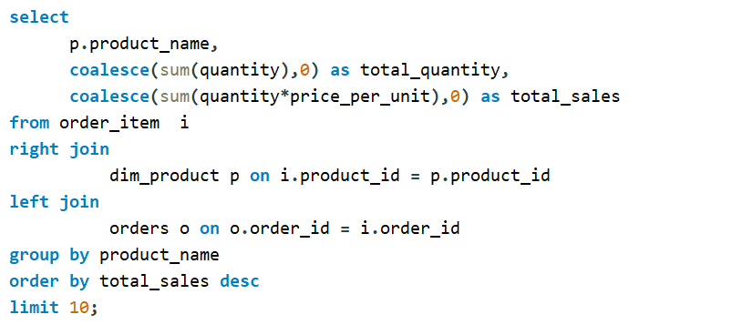
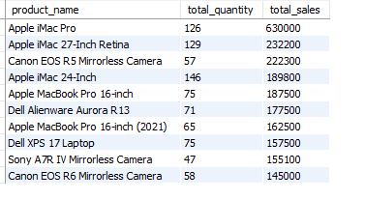
Request : 1
Top Selling Products
Query the top 10 products by total sales value.
Challenge: Include product name, total quantity sold, and total sales value.
A total of 760 products are available

Slide 6
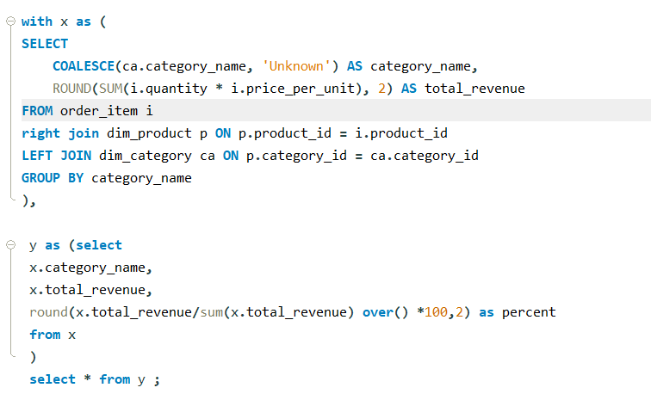
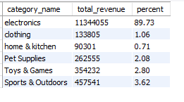
Request : 2
Revenue by Category
Calculate total revenue generated by each product category.
Challenge: Include the percentage contribution of each category to total revenue.

Slide 7
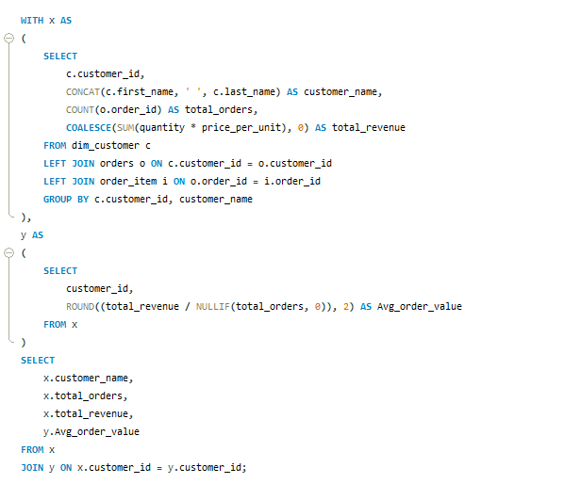
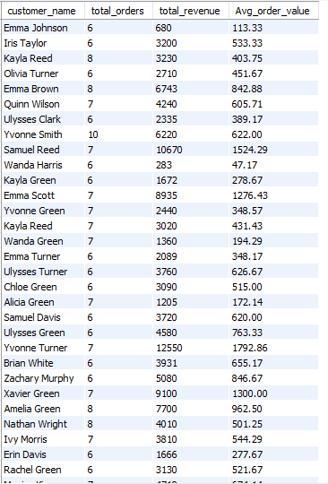
Request : 3
Average Order Value (AOV)
Compute the average order value for each customer.
Challenge: Include only customers with more than 5 orders..
There are 868 registered customers, of which 212 have never placed an order.

Slide 8
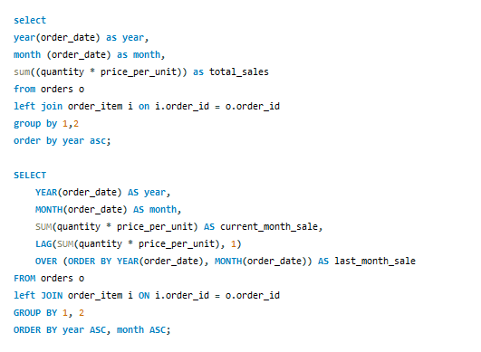
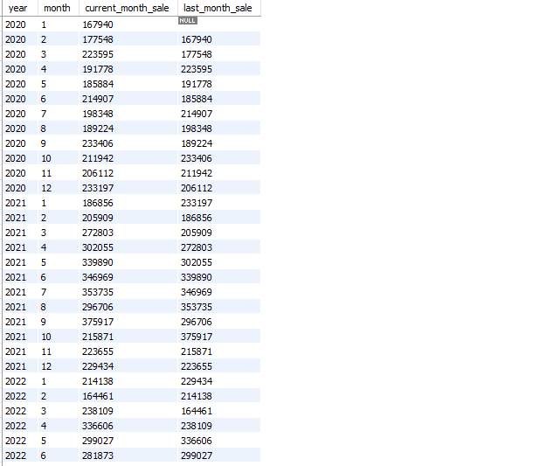
Request : 4
Monthly Sales Trend
Query monthly total sales over the past year.
Challenge: Display the sales trend, grouping by month, return current_month sale, last month sale.
55 rows were retrieved from the database for the date range January 2020 to July 2024

Slide 9
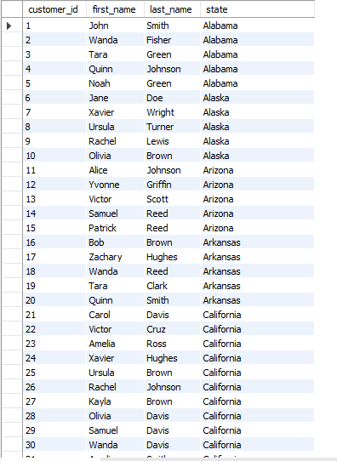
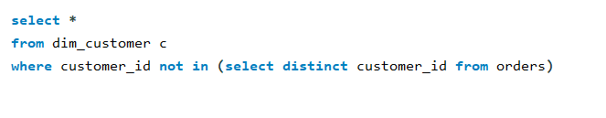
Request : 5
Customers with No Purchases
Find customers who have registered but never placed an order.
Challenge: List customer details and the time since their registration.
212 row has retrieved from database A total of 868 customers have registered, out of which 212 have never placed an order..

Slide 10
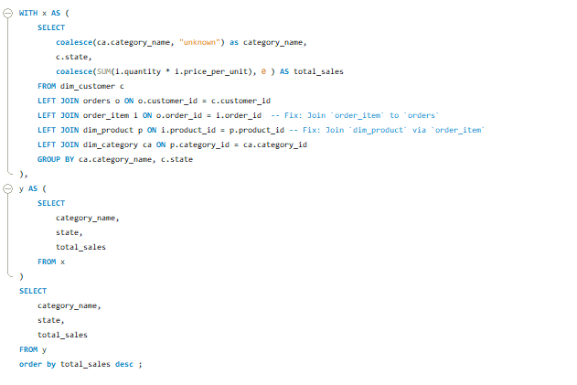
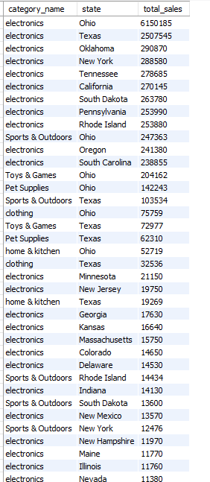
Request : 6
Least-Selling Categories by State
Identify the least-selling product category for each state.
Challenge: Include the total sales for that category within each state.
A total of 225 rows were retrieved from the database

Slide 11
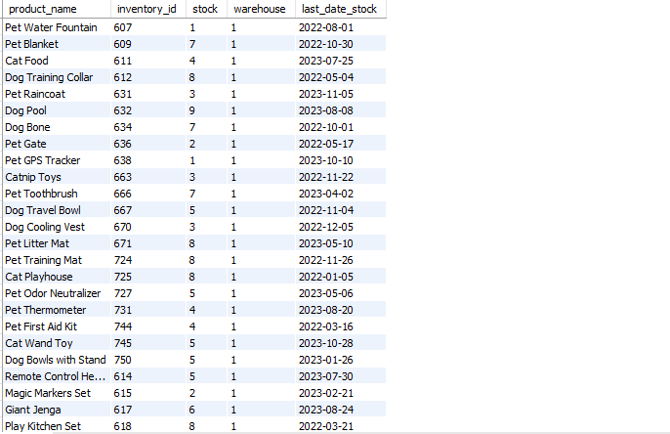
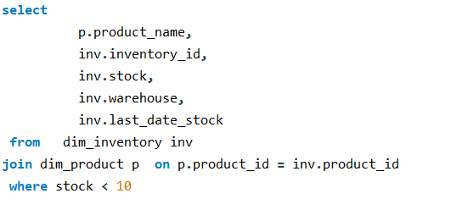
Request : 7
Inventory Stock Alerts
Query products with stock levels below a certain threshold (e.g., less than 10 units).
Challenge: Include last restock date and warehouse information.
There are 765 rows in total, and 51 rows have been retrieved.

Slide 12
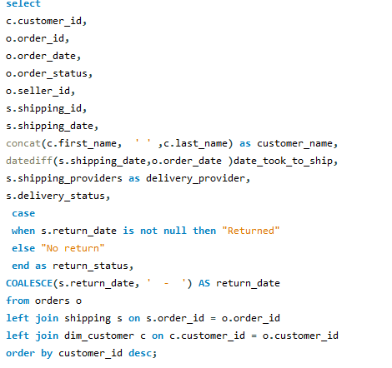
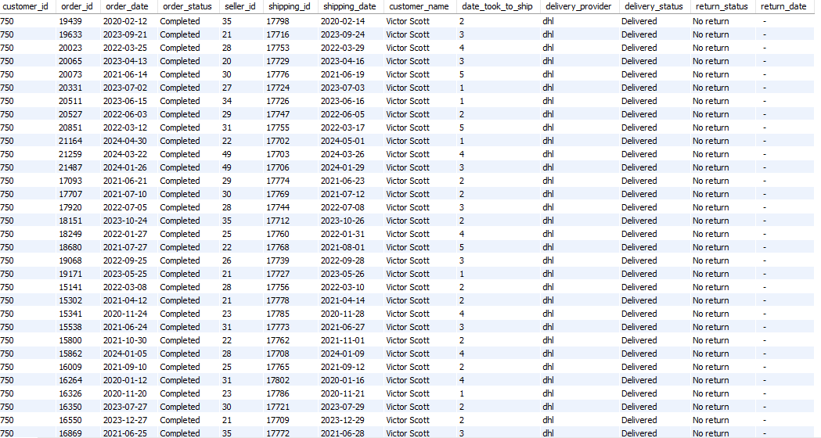
Request : 8
Shipping Delays
Identify orders where the days to ship after the order date.
Challenge: Include customer, order details, and delivery provider.
Click here to view
Total orders 21689 rows were retrieved

Slide 13
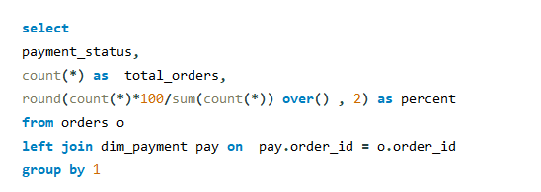

Request : 9
Payment Success Rate
Calculate the percentage of successful payments across all orders.
Challenge: Include breakdowns by payment status (e.g., failed, pending).
Total orders 21689

Slide 14
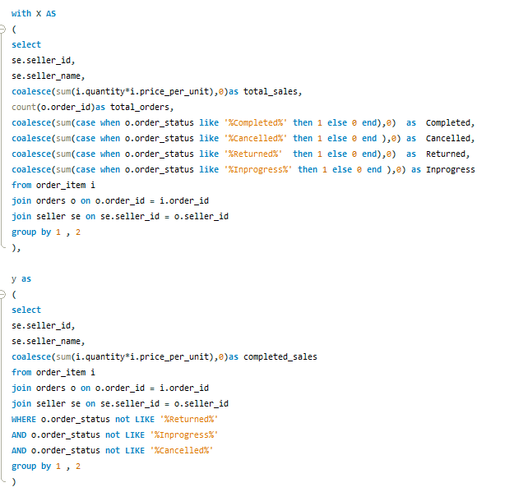
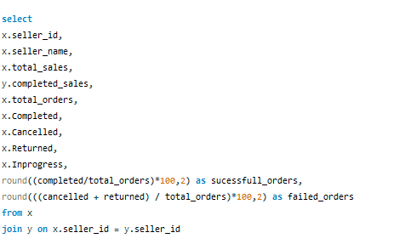
Request : 10
Seller Performance Based Upon their Orders
.
Click here to view

Slide 15
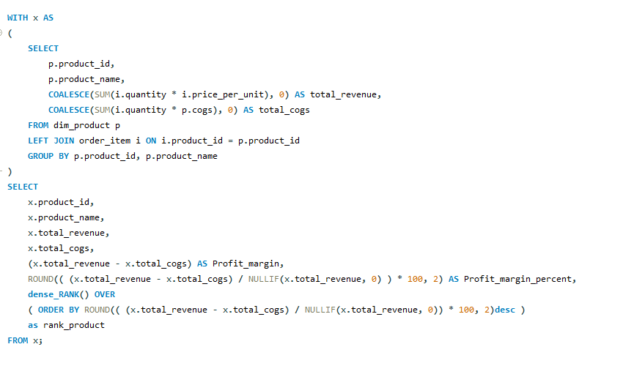
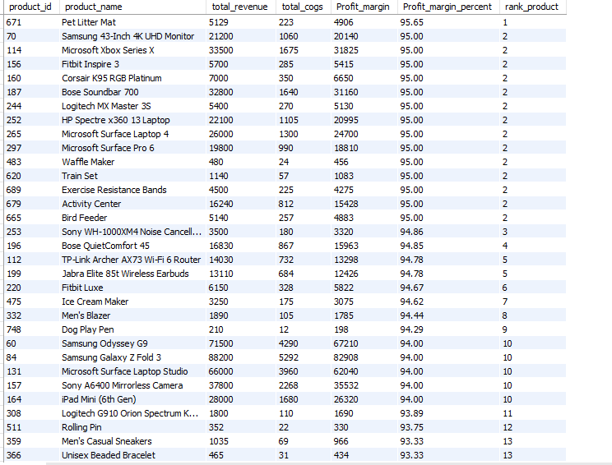
Request : 11
Product Profit Margin
Calculate the profit margin for each product (difference between price and cost of goods sold).
Challenge: Rank products by their profit margin, showing highest to lowest.
Click here to view

Slide 16
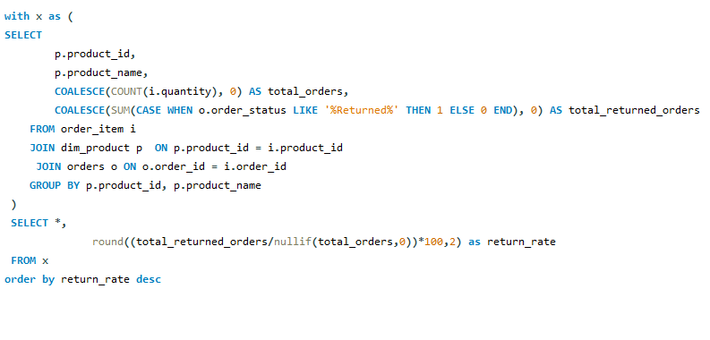
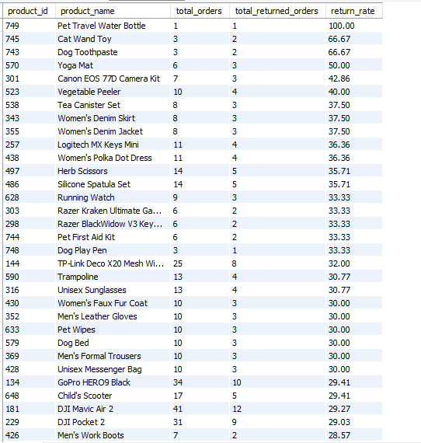
Request : 12
Click here to view
Most Returned Products
Query the products by the number of returns.
Challenge: Display the return rate as a percentage of total units sold for each product.
Out of the 765 registered products, 750 have been ordered at least once, resulting in an order conversion rate of approximately 98.04%

Slide 17
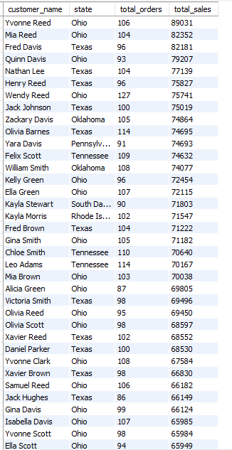
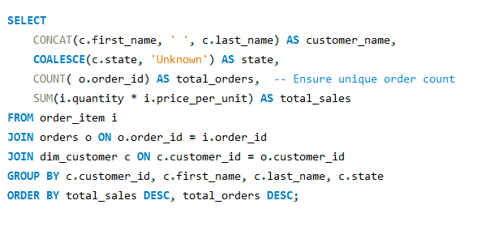
Request : 13
Customers by Orders in Each State
Identify the customers with the highest number of orders for each state.
Challenge: Include the number of orders and total sales for each customer.
Click here to view

Slide 18
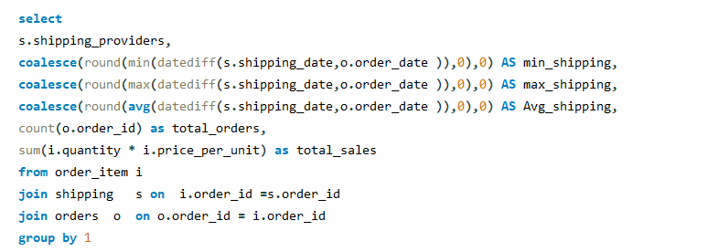

Request : 14
Revenue by Shipping Provider
Calculate the total revenue handled by each shipping provider.
Challenge: Include the total number of orders handled and the average delivery time for each provider.

Slide 19
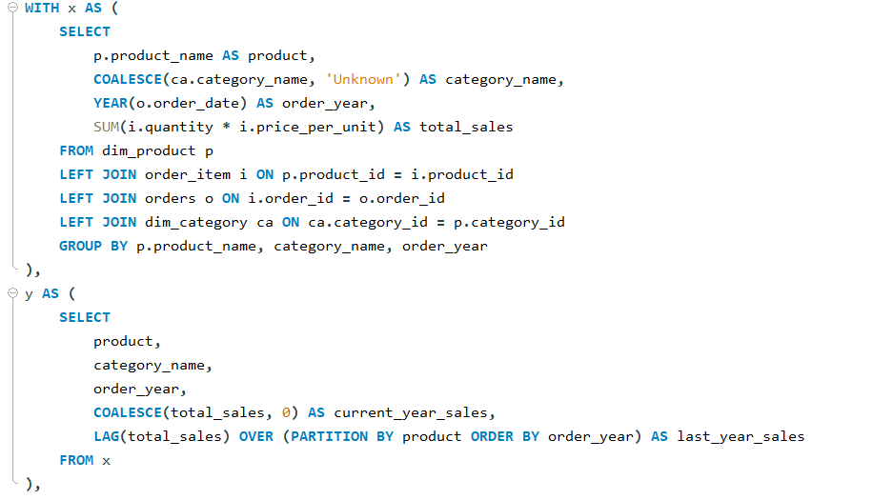
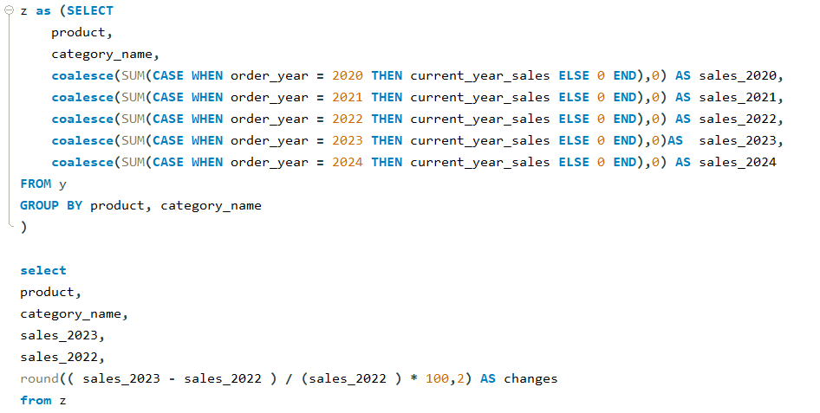
Request : 15
YOY revenue ratio
compare to last year(2022) and current_year(2023)
Challenge: Return product_id, product_name, category_name, 2022 revenue and 2023 revenue decrease ratio at end Round the result
Note: Decrease ratio = cr-ls/ls* 100 (cs = current_year ls=last_year)
Click here to view

Slide 20
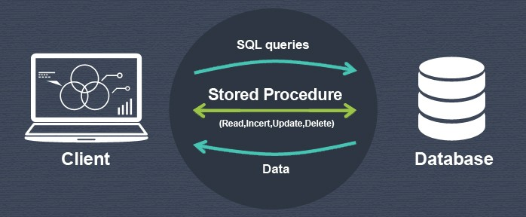
Store Procedures
A stored procedure is a prepared SQL code that you can save, so the code can be reused over and over again. So, if you have an SQL query that you write over and over again, save it as a stored procedure, and then just call it to execute it.

Slide 21
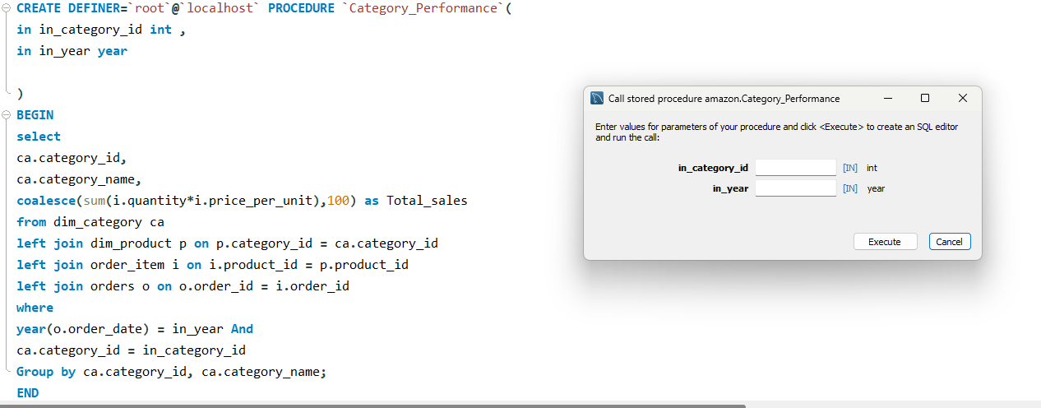
Request : 16
Category Performance
Store Procedures :-
In_category_id =
In_Year =

Slide 22
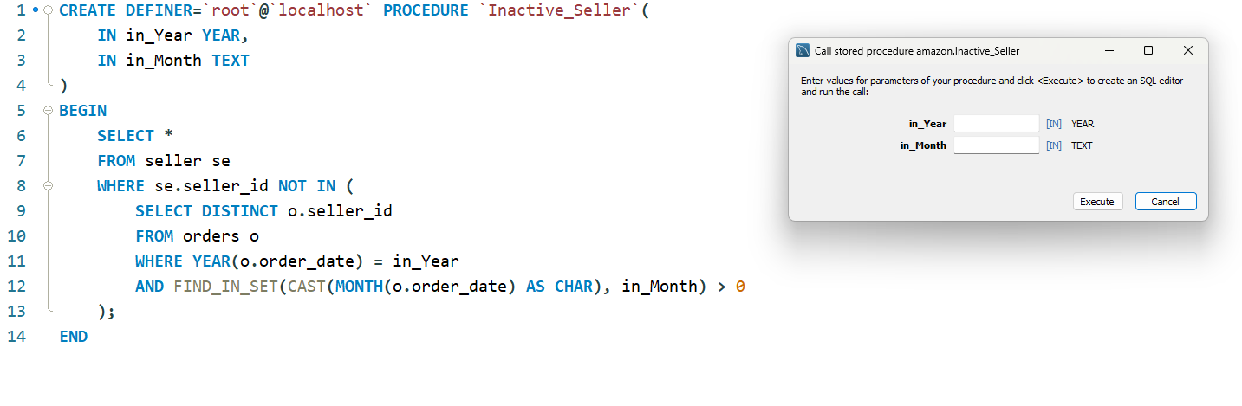
Request : 17
Inactive Seller
Store Procedures :-
In_Year =
In_Month=

Slide 23
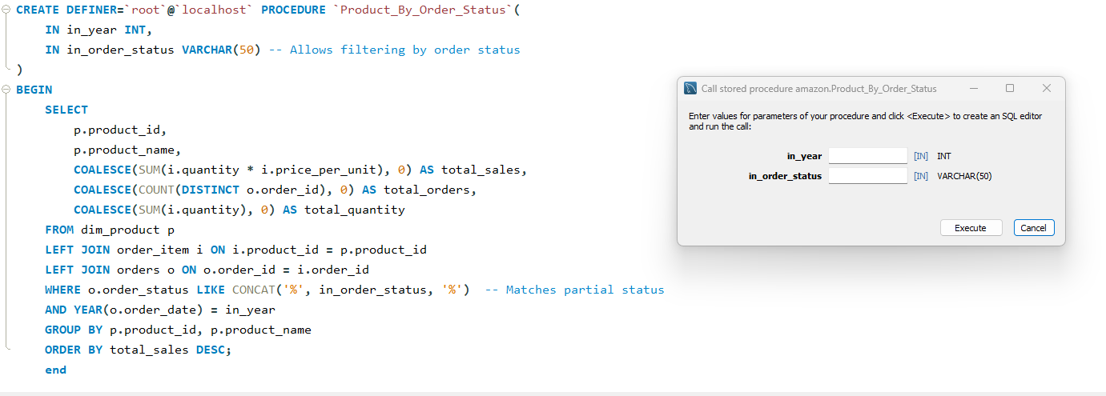
Request : 18
Product BY Order Status
Store Procedures :-
In_Year =
In_Order_Status=

Slide 24
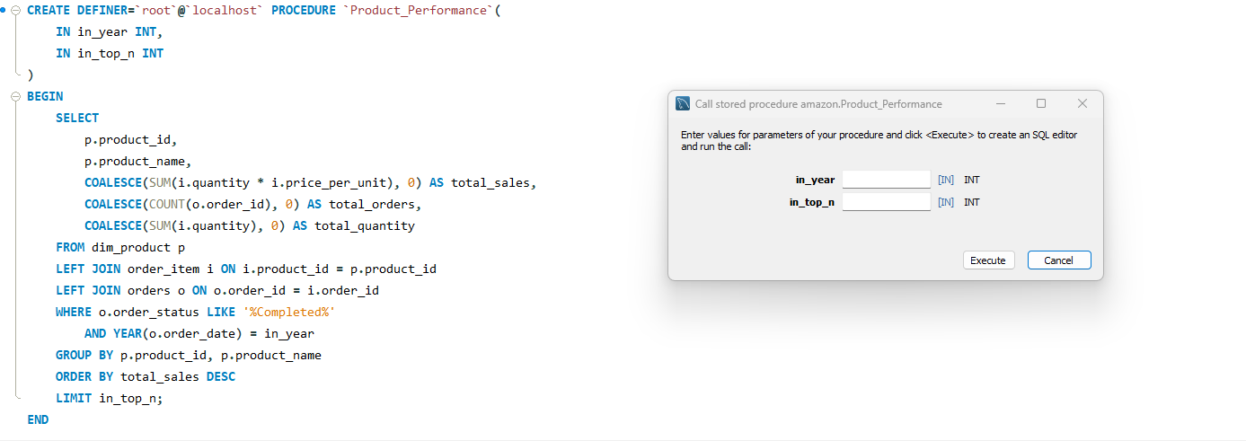
Request : 19
Product Performance By Top N
Store Procedures :-
In_Year =
In_top_n=

Slide 25
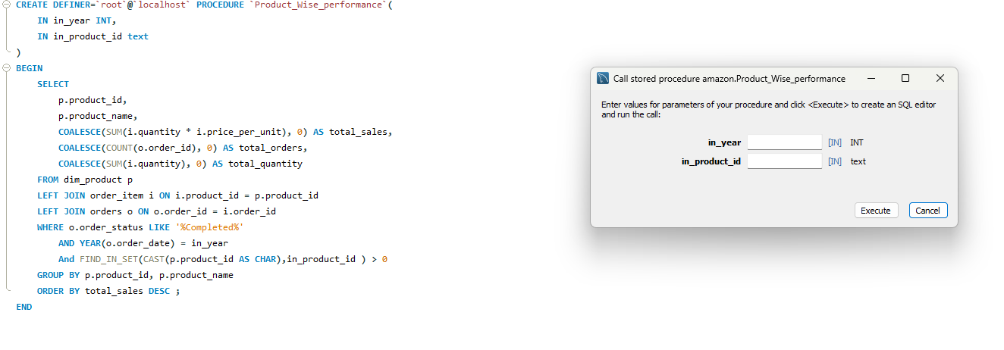
Request : 20
Product Performance
Store Procedures :-
In_Year =
In_product_id=

